Slide 1

Chapter 3
Data and Signals
3.<number>
Copyright © The McGraw-Hill Companies, Inc. Permission required for reproduction or display.

Slide 2

Note
To be transmitted, data must be transformed to electromagnetic signals.
3.<number>

Slide 3
3-1 ANALOG AND DIGITAL
Data can be analog or digital. The term analog data refers to information that is continuous; digital data refers to information that has discrete states. Analog data take on continuous values. Digital data take on discrete values.
Topics discussed in this section:
Analog and Digital Data
Analog and Digital Signals
Periodic and Nonperiodic Signals
3.<number>

Slide 4
Analog and Digital Data
Data can be analog or digital.
Analog data are continuous and take continuous values.
Digital data have discrete states and take discrete values.
Example: Analog and digital clock
3.<number>

Slide 5
Analog and Digital Signals
Signals can be analog or digital.
Analog signals can have an infinite number of values in a range.
Digital signals can have only a limited
number of values.
3.<number>

Slide 6

Figure 3.1 Comparison of analog and digital signals
3.<number>

Slide 7
Periodic and Non-periodic Signals
Periodic
  Complete a pattern within a measurable time frame, i.e., period
  Repeat the pattern over subsequent identical period
  Completion of one full pattern is called cycle.
  Use less bandhwidth
Non-Periodic
  Changes without exhibiting a pattern
  Can represents variation in data
3.<number>

Slide 8
3-2 PERIODIC ANALOG SIGNALS
Periodic analog signals can be classified as simple or composite.
A simple periodic analog signal, a sine wave, cannot be decomposed into simpler signals.
A composite periodic analog signal is composed of multiple sine waves.
3.<number>

Slide 9

Figure 3.2 A sine wave
3.<number>

Slide 10
Parameters A sine wave
Peak Amplitude
  Absolute value of its highest intensity.
  Measures in volts
  P#92
Period
  Amount of time a signal need to complete 1 cycle.
  Measures in seconds
  Period=Frequency
Frequency
  No of periods in 1 second
  Inverse to Period
  Hertz
P93 Example 3.3
3.<number>

Slide 11

Figure 3.3 Two signals with the same phase and frequency,
but different amplitudes
3.<number>

Slide 12

Note
Frequency and period are the inverse of each other.
3.<number>

Slide 13

Figure 3.4 Two signals with the same amplitude and phase,
but different frequencies
3.<number>

Slide 14

Table 3.1 Units of period and frequency
3.<number>

Slide 15

Example 3.1
The power we use at home has a frequency of 60 Hz. The period of this sine wave can be determined as follows:
3.<number>

Slide 16

Example 3.2
The period of a signal is 100 ms. What is its frequency in kilohertz?
Solution
First we change 100 ms to seconds, and then we calculate the frequency from the period (1 Hz = 10⁻³ kHz).
3.<number>

Slide 17
Frequency
Frequency is the rate of change with respect to time.
Change in a short span of time means high frequency.
Change over a long span of
time means low frequency.
3.<number>

Slide 18
Note
If a signal does not change at all, its frequency is zero.
If a signal changes instantaneously, its frequency is infinite.
3.<number>

Slide 19
Note
Phase describes the position of the waveform relative to time 0.
3.<number>

Slide 20

Figure 3.5 Three sine waves with the same amplitude and frequency,
but different phases
3.<number>

Slide 21

Example 3.3
A sine wave is offset 1/6 cycle with respect to time 0. What is its phase in degrees and radians?
Solution
We know that 1 complete cycle is 360°. Therefore, 1/6 cycle is
3.<number>

Slide 22

Figure 3.6 Wavelength and period
Wavelength: distance a simple signal can travel in one period
Propagation speed * Period= PS/Frequency
3.<number>

Slide 23

Figure 3.7 The time-domain and frequency-domain plots of a sine wave
3.<number>

Slide 24
Note
A complete sine wave in the time domain can be represented by one single spike in the frequency domain.
3.<number>

Slide 25
Example 3.7
The frequency domain is more compact and useful when we are dealing with more than one sine wave. For example, Figure 3.8 shows three sine waves, each with different amplitude and frequency. All can be represented by three spikes in the frequency domain.
3.<number>

Slide 26

Figure 3.8 The time domain and frequency domain of three sine waves
3.<number>

Slide 27
Signals and Communication
A single-frequency sine wave is not useful in data communications
We need to send a composite signal, a signal made of many simple sine waves.
According to Fourier analysis, any composite signal is a combination of simple sine waves with different frequencies, amplitudes, and phases.
3.<number>

Slide 28
Composite Signals and Periodicity
If the composite signal is periodic, the decomposition gives a series of signals with discrete frequencies.
If the composite signal is nonperiodic, the decomposition gives a combination of sine waves with continuous frequencies.
3.<number>

Slide 29
Bandwidth and Signal Frequency
The bandwidth of a composite signal is the difference between the highest and the lowest frequencies contained in that signal.
3.<number>

Slide 30

Figure 3.12 The bandwidth of periodic and nonperiodic composite signals
3.<number>

Slide 31

Example 3.6
If a periodic signal is decomposed into five sine waves with frequencies of 100, 300, 500, 700, and 900 Hz, what is its bandwidth? Draw the spectrum, assuming all components have a maximum amplitude of 10 V.
Solution
Let f_{h} be the highest frequency, f_{l} the lowest frequency, and B the bandwidth. Then
The spectrum has only five spikes, at 100, 300, 500, 700, and 900 Hz (see Figure 3.13).
3.<number>

Slide 32

Figure 3.13 The bandwidth for Example 3.6
3.<number>

Slide 33
Example 3.7
A periodic signal has a bandwidth of 20 Hz. The highest frequency is 60 Hz. What is the lowest frequency? Draw the spectrum if the signal contains all frequencies of the same amplitude.
Solution
Let f_{h} be the highest frequency, f_{l} the lowest frequency, and B the bandwidth. Then
The spectrum contains all integer frequencies. We show this by a series of spikes (see Figure 3.14).
3.<number>

Slide 34

Figure 3.14 The bandwidth for Example 3.7
3.<number>

Slide 35
Example 3.8
A nonperiodic composite signal has a bandwidth of 200 kHz, with a middle frequency of 140 kHz and peak amplitude of 20 V. The two extreme frequencies have an amplitude of 0. Draw the frequency domain of the signal.
Solution
The lowest frequency must be at 40 kHz and the highest at 240 kHz. Figure 3.15 shows the frequency domain and the bandwidth.
3.<number>

Slide 36

Figure 3.15 The bandwidth for Example 3.8
3.<number>

Slide 37
Example 3.9
An example of a nonperiodic composite signal is the signal propagated by an AM radio station. In the United States, each AM radio station is assigned a 10-kHz bandwidth. The total bandwidth dedicated to AM radio ranges from 530 to 1700 kHz. We will show the rationale behind this 10-kHz bandwidth in Chapter 5.
3.<number>

Slide 38
Example 3.10
Another example of a nonperiodic composite signal is the signal propagated by an FM radio station. In the United States, each FM radio station is assigned a 200-kHz bandwidth. The total bandwidth dedicated to FM radio ranges from 88 to 108 MHz. We will show the rationale behind this 200-kHz bandwidth in Chapter 5.
3.<number>

Slide 39
Example 3.11
Another example of a nonperiodic composite signal is the signal received by an old-fashioned analog black-and-white TV. A TV screen is made up of pixels. If we assume a resolution of 525 × 700, we have 367,500 pixels per screen. If we scan the screen 30 times per second, this is 367,500 × 30 = 11,025,000 pixels per second. The worst-case scenario is alternating black and white pixels. We can send 2 pixels per cycle. Therefore, we need 11,025,000 / 2 = 5,512,500 cycles per second, or Hz. The bandwidth needed is 5.5125 MHz.
3.<number>

Slide 40
Fourier Analysis
Note
Fourier analysis is a tool that changes a time domain signal to a frequency domain signal and vice versa.
3.<number>

Slide 41
Fourier Series
Every composite periodic signal can be represented with a series of sine and cosine functions.
The functions are integral harmonics of the fundamental frequency “f” of the composite signal.
Using the series we can decompose any periodic signal into its harmonics.
3.<number>

Slide 42
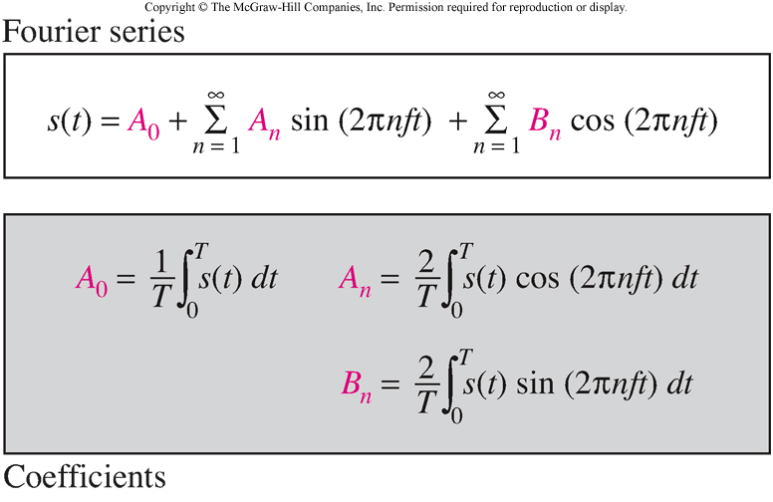
Fourier Series
3.<number>

Slide 43
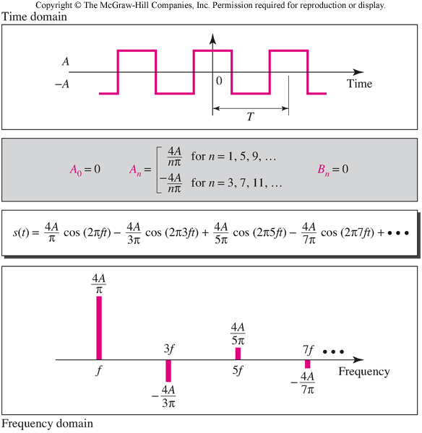
Examples of Signals and the Fourier Series Representation
3.<number>

Slide 44
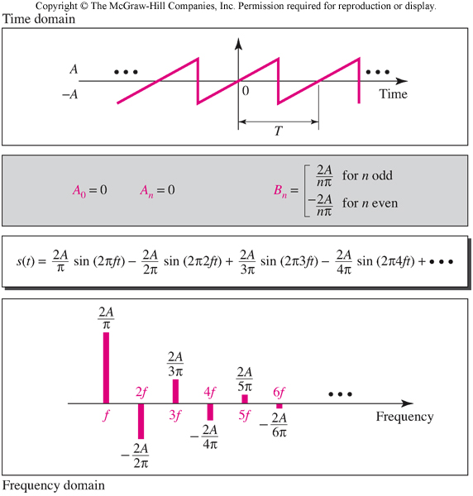
Sawtooth Signal
3.<number>

Slide 45
Fourier Transform
Fourier Transform gives the frequency domain of a nonperiodic time domain signal.
3.<number>

Slide 46
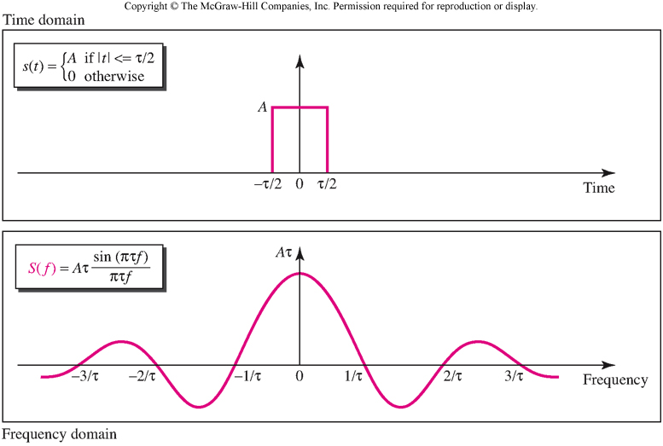
Example of a Fourier Transform
3.<number>

Slide 47
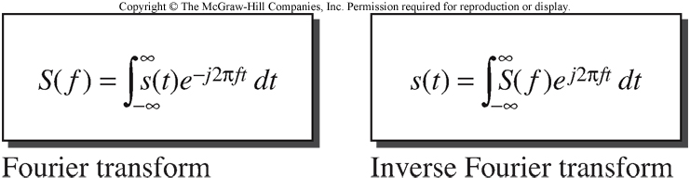
Inverse Fourier Transform
3.<number>

Slide 48
Time limited and Band limited Signals
A time limited signal is a signal for which the amplitude s(t) = 0 for t > T₁ and t < T₂
A band limited signal is a signal for which the amplitude S(f) = 0 for f > F₁ and f < F₂
3.<number>

